Slide 1
Chapter 2
By Cheuk-hang Tse

Slide 2
Variables and Function in Statistical Learning
The following are the variables and function used in statistical learning:
Input variable
Output variable
Estimate function
Error term

Slide 3
Example of Statistical Learning
Suppose there is an advertising data on TV, radio, and newspaper media.
If we can prove that advertising have a relationship on sales, then we can tell others that advertising increase/decrease sales.
Advertising budgets are the input variables
Sales is an output variable
Output variable is often called the response or dependent variable and is typically denoted using the symbol Y.

Slide 4
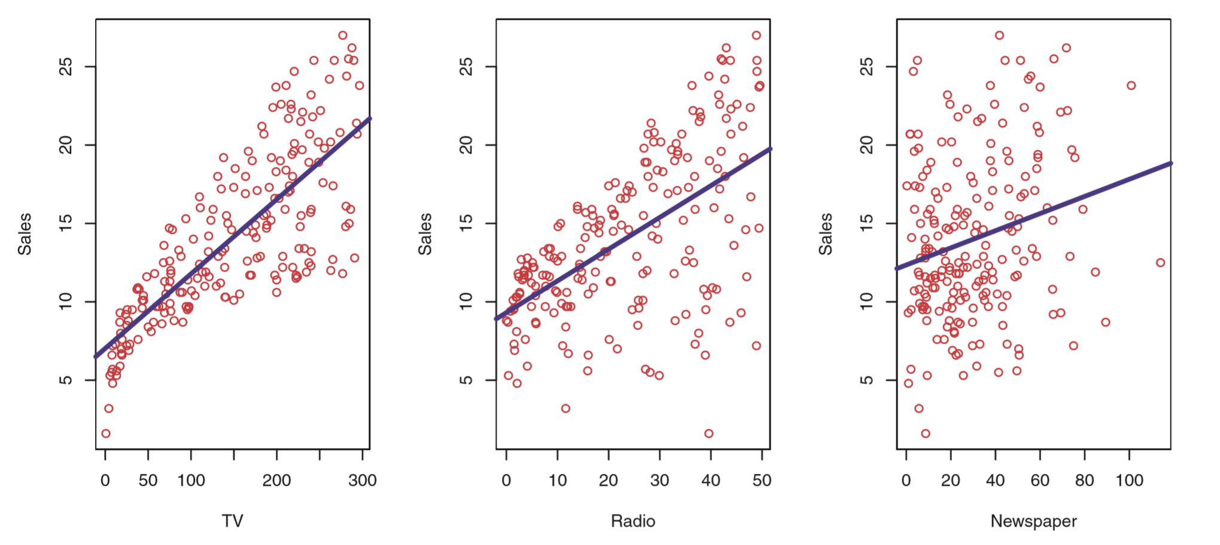
Function
In general form of relationship between X and Y is Y = f(X) + ϵ
f is some fixed but unknown function of X1, X2, … , Xp
ϵ is a random error term
f represents the systematic information that X provides about Y

Slide 5
Two main reasons that we may wish to estimate f
The two main reasons are:
Prediction
Inference

Slide 6
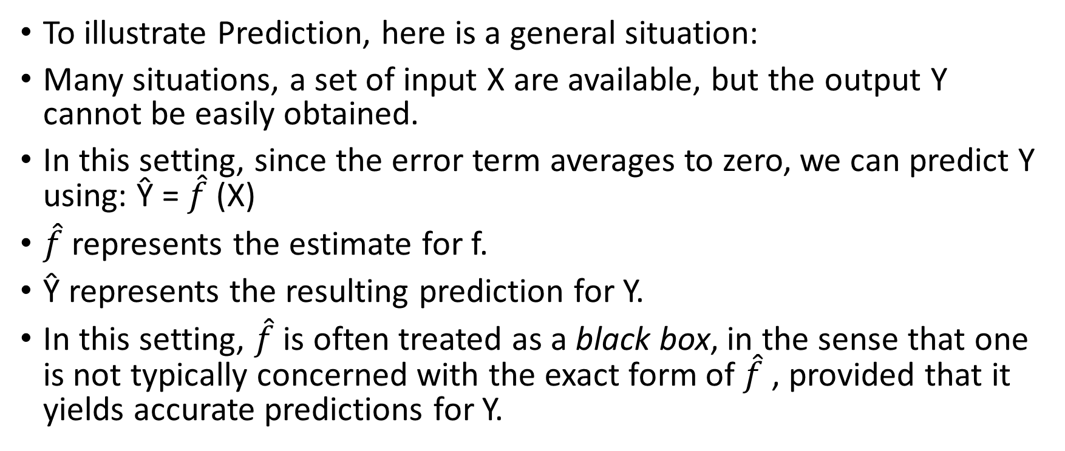
Prediction
To illustrate Prediction, here is a general situation:
Many situations, a set of input X are available, but the output Y cannot be easily obtained.
In this setting, since the error term averages to zero, we can predict Y using: Ŷ = $\hat{f}$ (X)
$\hat{f}$ represents the estimate for f.
Ŷ represents the resulting prediction for Y.
In this setting, $\hat{f}$ is often treated as a black box, in the sense that one is not typically concerned with the exact form of $\hat{f}$ , provided that it yields accurate predictions for Y.

Slide 7
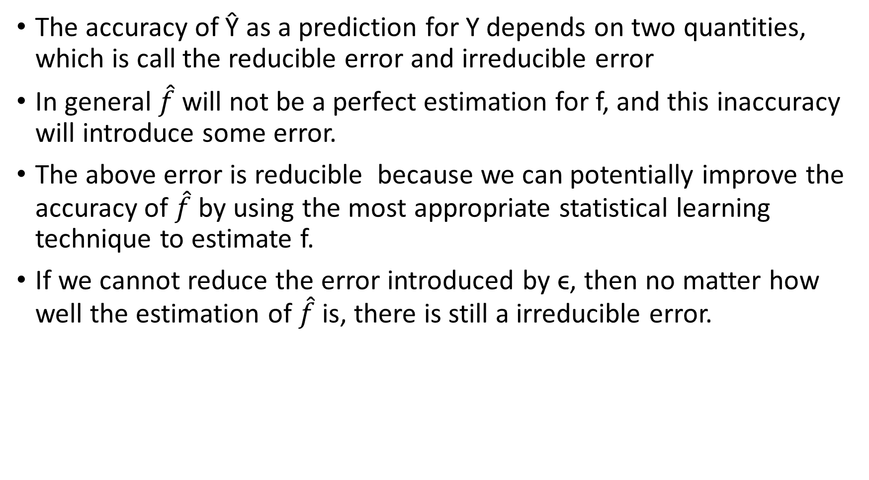
The accuracy of Ŷ as a prediction for Y depends on two quantities, which is call the reducible error and irreducible error
In general $\hat{f}$ will not be a perfect estimation for f, and this inaccuracy will introduce some error.
The above error is reducible because we can potentially improve the accuracy of $\hat{f}$ by using the most appropriate statistical learning technique to estimate f.
If we cannot reduce the error introduced by ϵ, then no matter how well the estimation of $\hat{f}$ is, there is still a irreducible error.

Slide 8
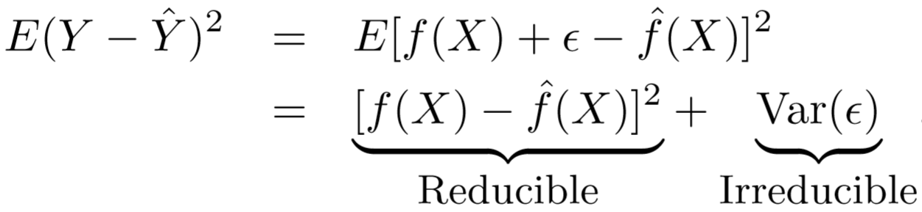
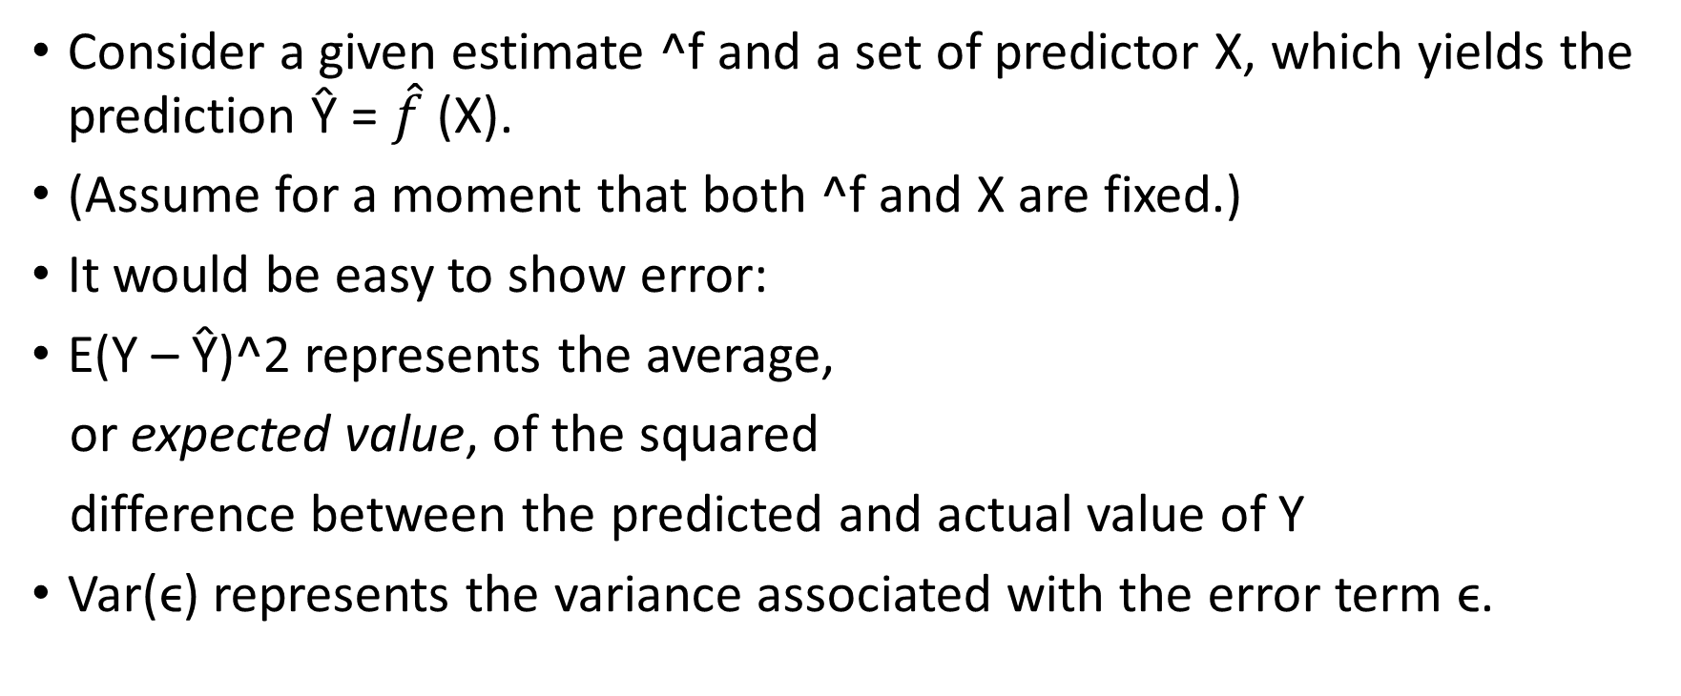
Example of error
Consider a given estimate ^f and a set of predictor X, which yields the prediction Ŷ = $\hat{f}$ (X).
(Assume for a moment that both ^f and X are fixed.)
It would be easy to show error:
E(Y – Ŷ)^2 represents the average,
or expected value, of the squared
difference between the predicted and actual value of Y
Var(ϵ) represents the variance associated with the error term ϵ.

Slide 9

Inference
Estimating f, but not necessarily to make predictions for Y. Instead, to understand the relationship between X and Y.
Therefore, now $\hat{f}$ cannot be treated as a black box because we need to know its exact form.

Slide 10
Difference in Question Between Prediction and Inference
Seeks to relate the values of homes to inputs.
Inputs such as crime rate, zoning, distance from a river, air quality, etc.
A inference problem will looks like: How much extra will a house worth if it has a view of the river?
A prediction problem will looks like: Predicting the value of a home given its characteristic: is the house under or over-valued?

Slide 11
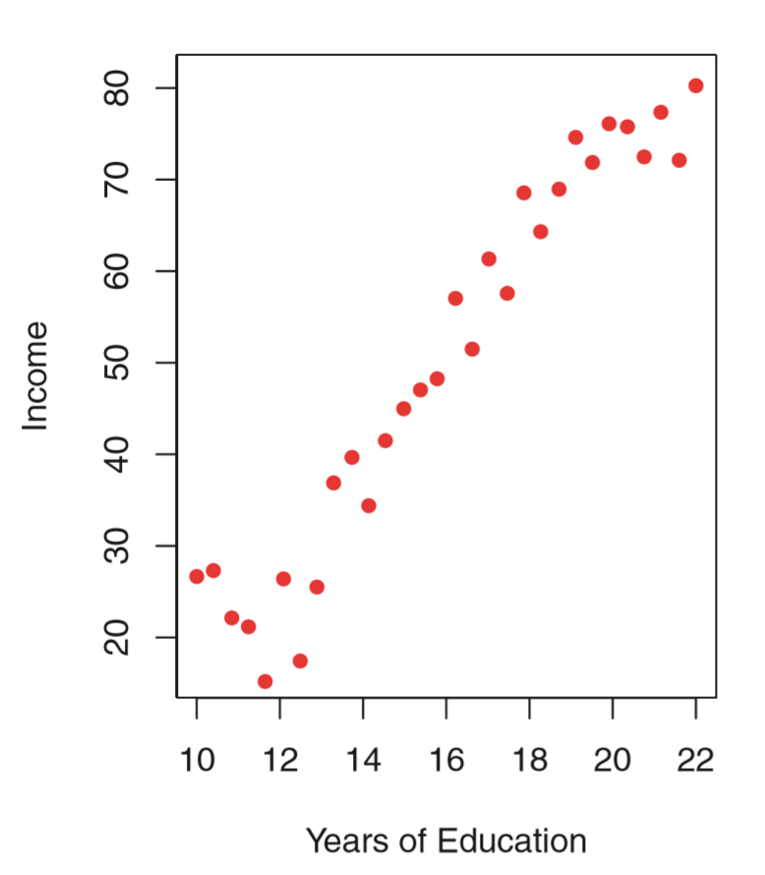
How to estimate f ?
Need to always assume that we have observed a set of n different data points.
These observations are called the training data
Use these observations to train the method on how to estimate f.
The goal is to estimate the unknown function f.

Slide 12
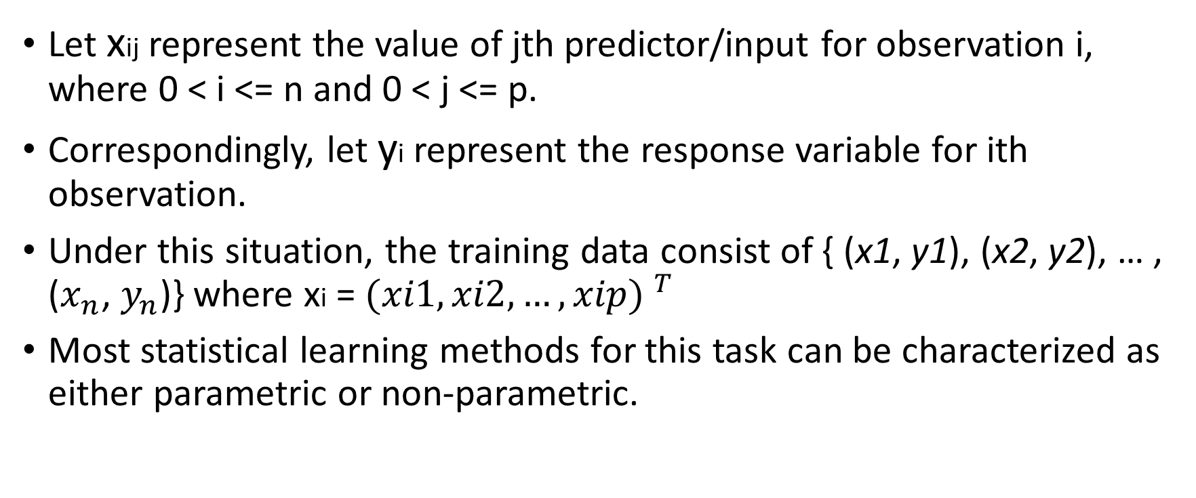
Training Data
Let xij represent the value of jth predictor/input for observation i, where 0 < i <= n and 0 < j <= p.
Correspondingly, let yi represent the response variable for ith observation.
Under this situation, the training data consist of { (x1, y1), (x2, y2), … , ($x_{n}$, $y_{n}$)} where xi = ${(xi1, xi2, …, xip) }^{T}$
Most statistical learning methods for this task can be characterized as either parametric or non-parametric.

Slide 13
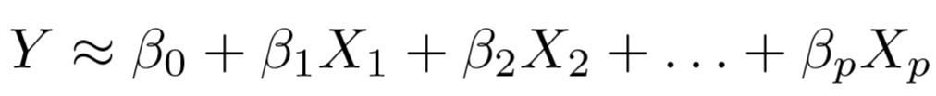
Parametric
Parametric methods involve a two-step model-based approach.
Make an assumption about the functional form, or shape, of f.
EX: Assume f(X) is linear: f(X) = β0 + β1 X1 + β2 X2 + … + βp Xp
now we only need to estimate p+1 coefficients β0, β1 … βp.
Need a procedure that uses the training data to fit or train the model.
To find values to β0, β1 … βp such that
The common approach to fitting the model is referred as (ordinary) least squares. (Will discuss in Chapter 3)

Slide 14
The model-based approach just described is referred to as parametric.
It reduce the problem of estimating f down to one of estimating a set of parameters.
EX: Assuming a parametric form for f simplifies the problem of estimating f than it is to fit an entirely arbitrary function f.

Slide 15
Disadvantage
The model we choose will usually not match the true unknown form of f.
If chosen model is too far from true f, then the estimation will be poor.
Choosing flexible models that can fit many different possible functional forms for f.
Fitting a more flexible model requires estimating a greater number of parameters.
Those more complex models can lead to overfitting the data, which means they follow the errors too closely.

Slide 16
Non-parametric
Do not make explicit assumption about the function form of f.
Seek an estimate of f that gets as close to the data points as possible without being too rough.
The potential to accurately fit a wider range of possible shapes for f.
Avoid the danger of resulting model does not fit the data, since no assumption is made to the form of f.

Slide 17
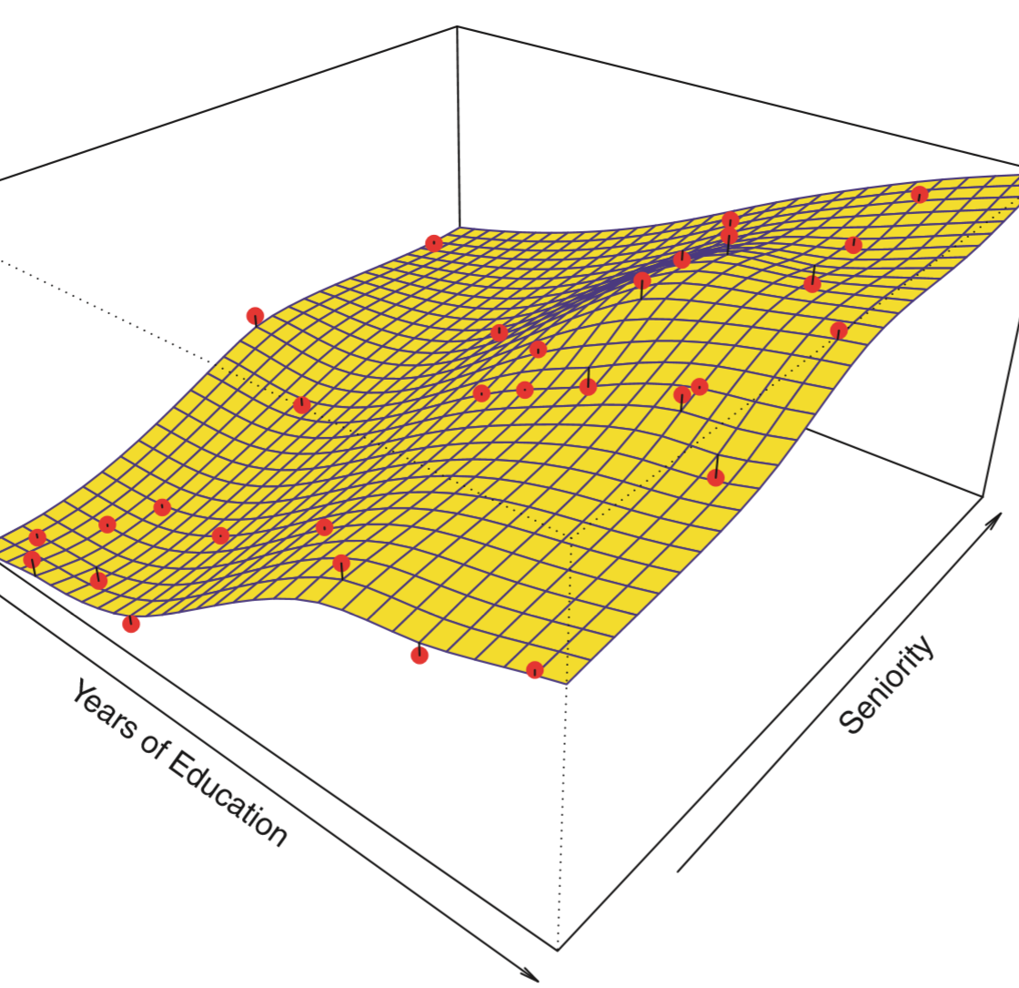
Disadvantage and Example
Suffers from a very large number of observation because it is required in order to obtain an accurate estimate for f.
Example: non-parametric approach to fitting the Income data.
A thin-plate spline is used to estimate f:
- This does not impose an pre-specified model on f.
- It instead attempts to produce an estimate for f that is as close as possible to the observed data, subject to the fit (yellow surface)
In order to fit a thin-plate spline, we must select a level of smoothness.

Slide 18
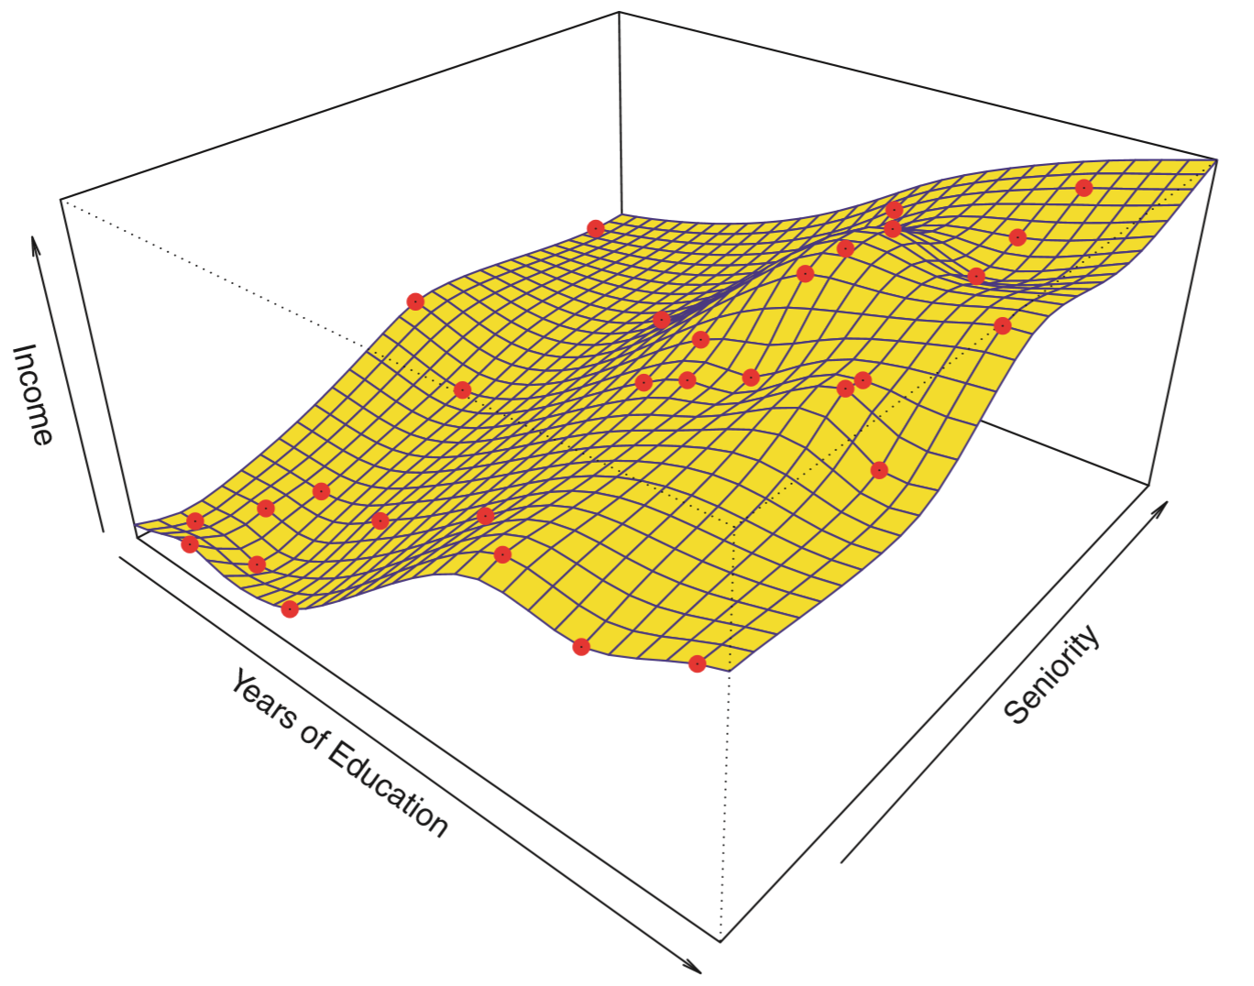
After using lower level of smoothness
The same thin-plate graph, but select a lower level of smoothness.
The resulting estimate fits the observed data perfectly.
However, the spline fit shown is far more variable than the true f.

Slide 19
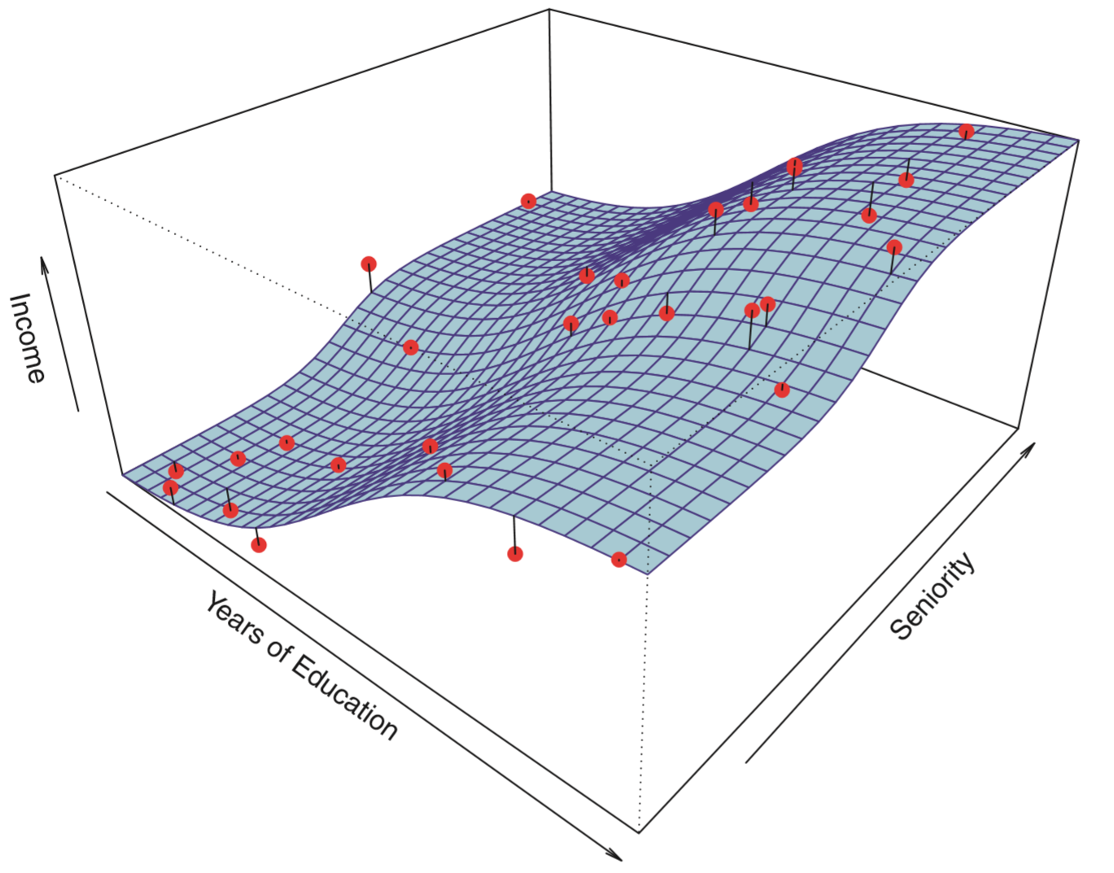
True function f
This is an example of overfitting the data.
Undesirable situation
More variable

Slide 20
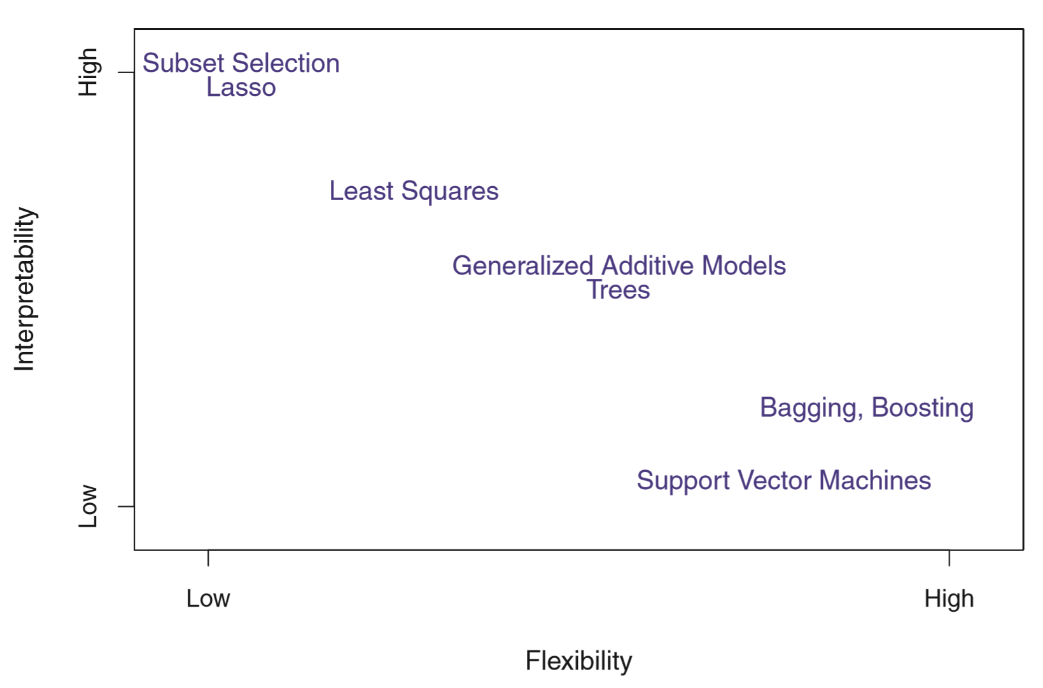
The Trade-Off Between Prediction Accuracy and Model Interpretability
Statistical learning methods have different characteristics.
Some are less flexible or some are more restrictive.
For example, linear regression is an inflexible approach because it can only generate linear functions.

Slide 21
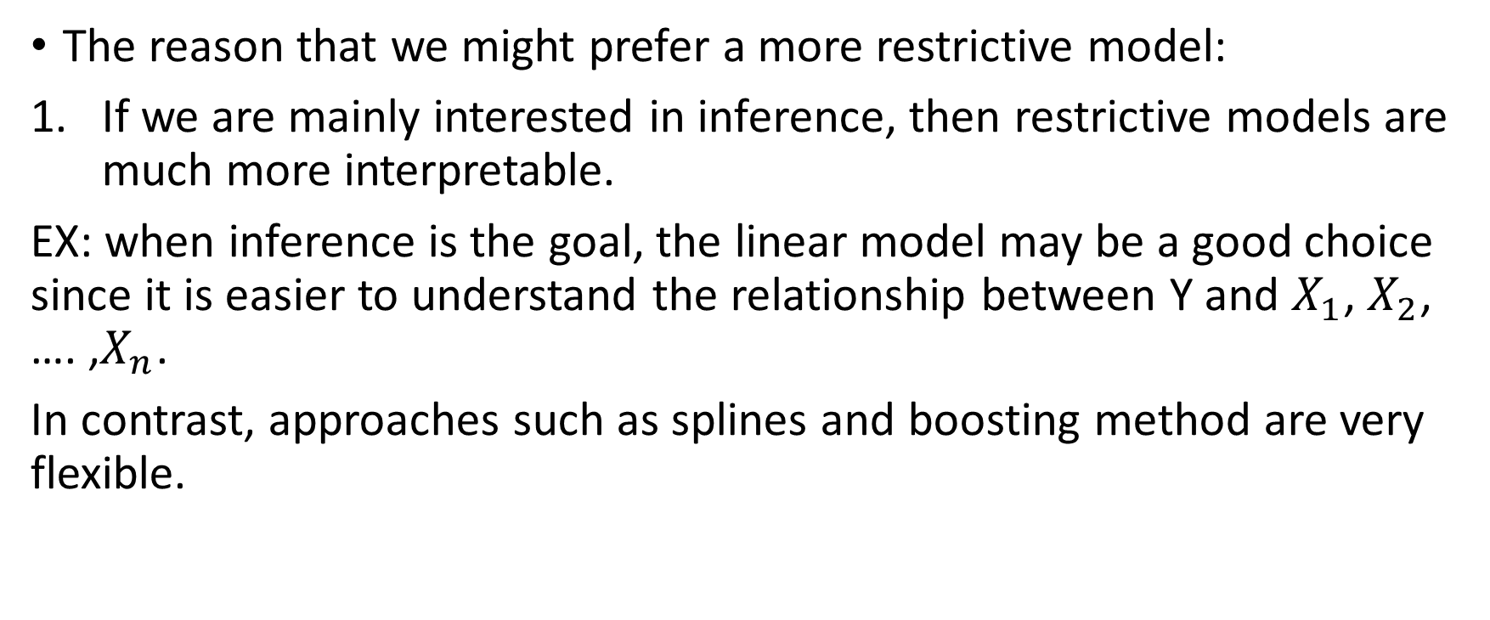
Deciding when to use a restrictive or flexible approach
The reason that we might prefer a more restrictive model:
If we are mainly interested in inference, then restrictive models are much more interpretable.
EX: when inference is the goal, the linear model may be a good choice since it is easier to understand the relationship between Y and $X_{1}$, $X_{2}$, …. ,$X_{n}$.
In contrast, approaches such as splines and boosting method are very flexible.

Slide 22
However, GAM is more flexible but less interpretable than linear regression.
Non-linear methods such as bagging, boosting, and support vector machines with non-linear kernels are highly flexible approaches.
When inference is the goal, there are clear advantage to using simple and relatively inflexible statistical learning methods.
Also it might be best to use a more flexible model when the requirement for the algorithm is to predict accurately, not to interpret.

Slide 23
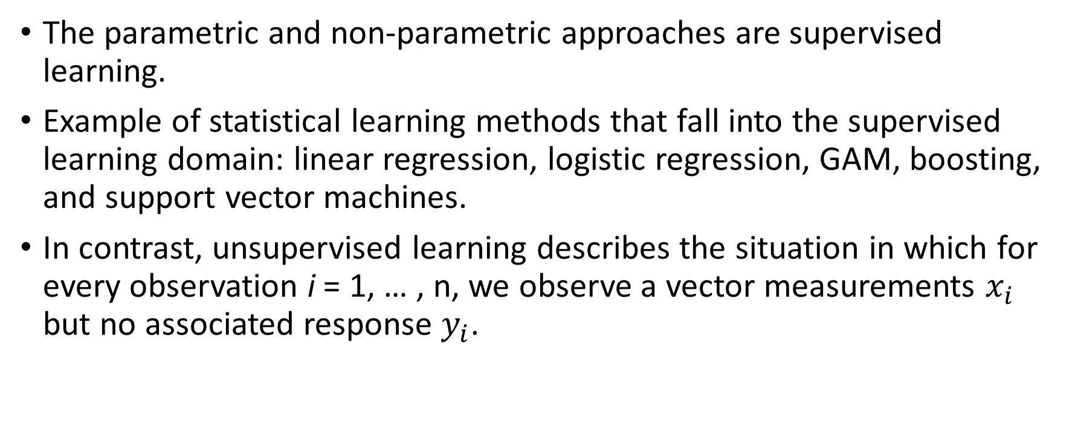
Supervised VS Unsupervised Learning
The parametric and non-parametric approaches are supervised learning.
Example of statistical learning methods that fall into the supervised learning domain: linear regression, logistic regression, GAM, boosting, and support vector machines.
In contrast, unsupervised learning describes the situation in which for every observation i = 1, … , n, we observe a vector measurements $x_{i}$ but no associated response $y_{i}$.

Slide 24
Use linear regression as an example:
Linear regression is a supervised learning method because there are predictor x is an associated response to the measurement y.
Therefore, one statistical learning tool may use in this setting is cluster analysis.
The goal for cluster analysis is to ascertain whether the observations fall into relatively distinct groups.

Slide 25
Example of Cluster analysis
Cluster analysis is:
Suppose there is a market segmentation study, we might observe multiple characteristics (variables) for potential customers.
Characteristics like: zip code, family income, and shopping habits.
Assume that customers fall into these two different groups: big spenders and low spenders.
In this setting, we can try to cluster the customers on the basis of the variable measured, in order to identify distinct groups of potential customers.

Slide 26
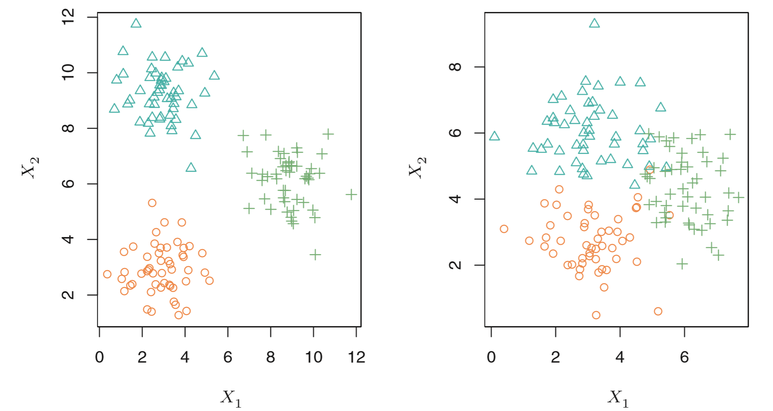
Illustration of the clustering problem
Have 150 observations with measurements on two variables, X1 and X2.
Each observation corresponds to one of three distinct groups.
However, the group memberships are unknown, and the goal is to determine the group to which each observation belongs.
The left panel is relatively easy task to sort into group because groups are well-separated
However, the right panel is more challenging because some are overlapped between the groups.

Slide 27
In practice, it is often that we can encounter data sets that contain many more than two variables.
If there are p variables in our data set, the p(p-1)/2 distinct scatterplots can be made, and visual inspection is simply not a viable way to identify clusters. Therefore automated clustering methods are important.

Slide 28
Semi-supervised Learning Method
For n observations, there are m pairs of predictors and responses, but for also have n-m measurements of predictor, but no corresponding response.
For this setting, it is suggested to use a statistical learning method that can incorporate the m observations also with the n-m observations that response measurement is not available.

Slide 29
Regression VS Classification Problem
Variables are characterized as either quantitative or qualitative.
Problems with a quantitative response referred as regression problems
What normal people would do when selecting statistical learning methods is to base on the response is quantitative or qualitative.
However, generally the predictors are qualitative or quantitative is less important.

Slide 30
Chapter 2.2 Assessing Model Accuracy
This section discuss some of the important concepts that arise in selecting a statistical learning procedure for a specific data set
Measuring the Quality of Fit
MSE (mean squared error) is the average squared difference between the estimated values and the actual values.
MSE will be small if the predicted responses are very close to the true responses.
Training MSE
Test MSE

Slide 31
Example
Suppose that we have clinical measurements (weight, blood pressure, height, age, and family history of disease) for a number of patients.
As well as information about whether each patient has diabetes.
Goal is to find a method that can accurately predicts diabetes risk for future patients based on their clinical measurements.
There will be 5 steps.

Slide 32
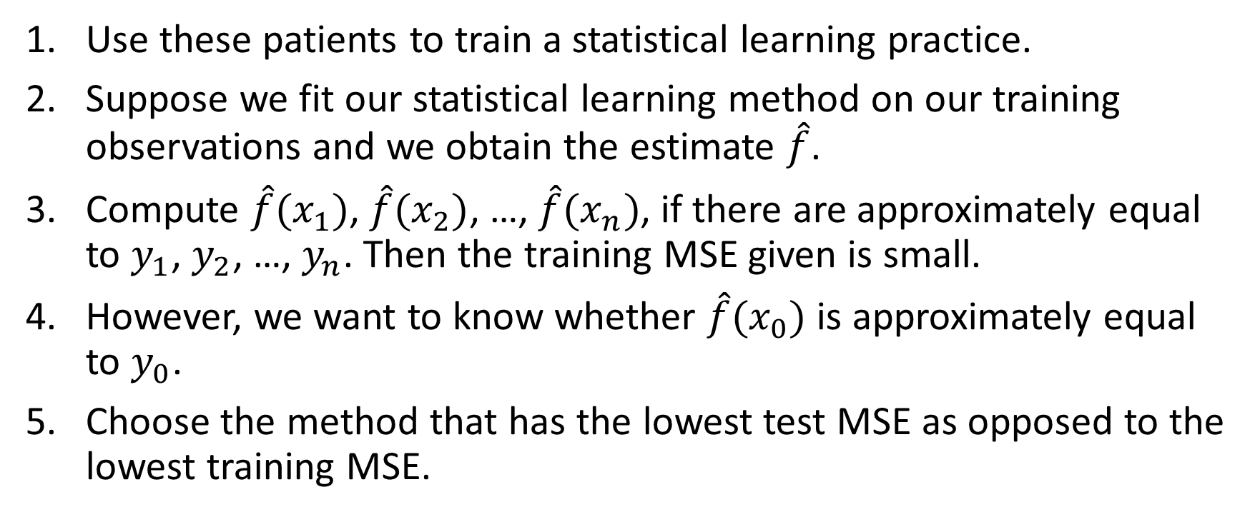
Use these patients to train a statistical learning practice.
Suppose we fit our statistical learning method on our training observations and we obtain the estimate $\hat{f}$.
Compute $\hat{f}{(x}_{1})$, $\hat{f}{(x}_{2})$, …, $\hat{f}{(x}_{n})$, if there are approximately equal to $y_{1}$, $y_{2}$, …, $y_{n}$. Then the training MSE given is small.
However, we want to know whether $\hat{f}{(x}_{0})$ is approximately equal to $y_{0}$.
Choose the method that has the lowest test MSE as opposed to the lowest training MSE.

Slide 33


The Bias-Variance Trade-Off
Expected test MSE
Expected test MSE can never lie below Var(ϵ), the irreducible error
Variance
Bias

